Slide 1

MONITORING
LECTURE 4 MODULE 3

Slide 2

LECTURE OUTLINE
Topic 1.
Monitoring
1
Topic 2.
What and how often to monitor?
2
Topic 3.
Overview of some monitoring tools
3
Topic 4.
Examples from some monitoring tools
4
Topic 5.
Deriving meaning from monitoring data
5

Slide 3

MONITORING

Slide 4

WHY IS IT NECESSARY?
Modern IT systems have tons of moving parts. To detect problems, it is critical to understand what goes on deep inside the system components rather than always looking at it from the outside.

Slide 5
WHAT AND HOW OFTEN TO MONITOR?

Slide 6


LEVELS OF MONITORING
System level monitoring
Operating system level
Application level
Application component level

Slide 7
Monitoring vs Profiling
Monitoring
It collects useful system characteristics continuously and is usually automated
Should provide a holistic view and a little bit detail as needed for each component
Should be setup carefully not to have impact on the system performance because it will always be present
Profiling
Can be consider as a subset of monitoring
Used to troubleshoot/debug system issues
Used to go deeper into the details and could focus on just one part of the system
Profiling can be done even with knowing that it adds overhead

Slide 8
OVERVIEW OF SOME MONITORING TOOLS

Slide 9

SOME MONITORING SOLUTIONS
Elastic search (my favorite so far)
Zabbix
NMON
Grafana
Nagios
So on..

Slide 10
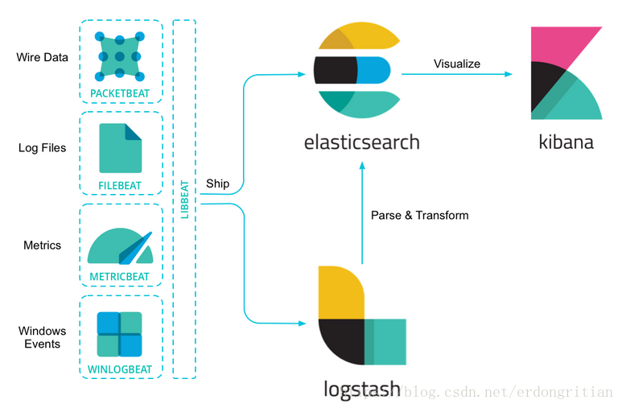
AN INTRODUCTION AND BRIEF ABOUT ELASTIC STACK
Some great features
Excellent search capabilities
Excellent scaling and availability
Excellent customizable graphs
Excellent support and community
Elastic decided to change future versions non-open source, but we have OpenSearch (A fork by AWS)
A quick walkthrough of my local Elastic stack

Slide 11
TYPES OF PROFILING TOOLS
Purpose
General purpose e.g. DynaTrace
Language specific e.g. JConsole, JProfiler etc.
Nature of profiling
Instrumentation: More details with higher overhead
Sampling: Less details, less overhead

Slide 12
EXAMPLES FROM SOME REAL-LIFE MONITORING

Slide 13
A REAL LIFE EXAMPLE FROM NMON MONITORING
Let's look at the NMON files

Slide 14
DERIVE MEANING FROM MONITORING DATA - THE ANALYSIS

Slide 15
A TASK TO ANALYZE SOME TEST RESULTS
Find the average files processed per second for each unique test name from the shared test result file

Slide 16
THANK YOU!

